Slide 1

Gouvieux Winter Edition 2018
GDPR en Microsoft Jurgen van den Broek
Albert Hoitingh

Slide 2
Wat is GDPR/AVG?
Nieuwe Europese wet verordening bescherming persoonsgegevens
Impact op alle bedrijfsprocessen en alle informatiesystemen binnen alle organisaties
Zoekt de balans tussen vrij verkeer van gegevens en privacy
Key concepts GDPR
✓ Consent
✓ Right to data portability
✓ Processing limitation
✓ Complaint management
✓ Right to be forgotten
✓ Right to compens. & liability
✓ Protection of minors
✓ Profiling
Genetic
Mental
Cultural
Economic
Social
Fines of up to 20 million euros or 4% of world wide annual turnover
Authority can issue instruction
to cease processing
Non-compliance can lead to loss of brand reputation and trust
Notes:
GDPR = General Data Protection Regulation AVG = algemene verordening gegevensbescherming
Deze verordening vervangt de databeschermingsrichtlijn uit 1995. Die sloot niet meer aan op de huidige digitale wereld. GDPR = 'bescherming van natuurlijke personen in verband met de verwerking van persoonsgegevens en betreffende het vrije verkeer van die gegevens’. EN om afspraken hieromtrent te uniformiseren binnen EU.
Waarom impact: Demonstreren van accountability
Uitleggen wat zijn persoonsgegevens en wat is verwerking?

Slide 3

Het recht van de EU inwoner
Opvragen van alle PII (personal identifiable information) die door een organisatie wordt opgeslagen en bewerkt
Binnen 30 dagen een reactie
Het recht om vergeten te worden
Akkoord geven op het verwerken van persoonlijk informatie

Slide 4


PII (Personal Identifiable Information)
Any information that can be used to identify an individual directly or indirectly. This could be data of clients, employees, suppliers, stakeholders, etc.
Fingerprints
Name, surname, age
CVs, assessments, salary slips
Religious affiliation
Bank details
Religion
Health-related data
...
Professional and private contact details
Interests & hobbies

Slide 5

De plicht voor de organisatie
Bewustwording faciliteren
Zorgdragen voor data protection cq. privacy officers
Binnen 72 uur een datalek rapporteren
Aantoonbaar (audit) processen gebruiken om te voldoen aan de regelgeving
Classificeren van alle bestaande informatie
Ervoor zorgen dat bestaande platformen compliant worden
72
Geldt voor elke organisatie met meer dan 250 medewerkers welke informatie over EU inwoners verwerkt.

Slide 6
Data verwerking
Sequence of structured operations, manual or automated, on Personal Data: consulting, collecting, transferring, destroying, etc.
It involves processes from start to finish: activities, stakeholders, and the means used, whether in the paper, computerized or application format
Data transfer is a processing operation which is much more frequent than it appears
Examples of data transfer
Consulting data on the intranet
Data hosting on servers (cloud)
Direct file transfer
Access to data via application maintenance
Notes:
Case: wehkamp> wat is verwerken > ook Cloudpartners, Testers, Backuppartijen, externe marketing bureaus. Inktvl

Slide 7
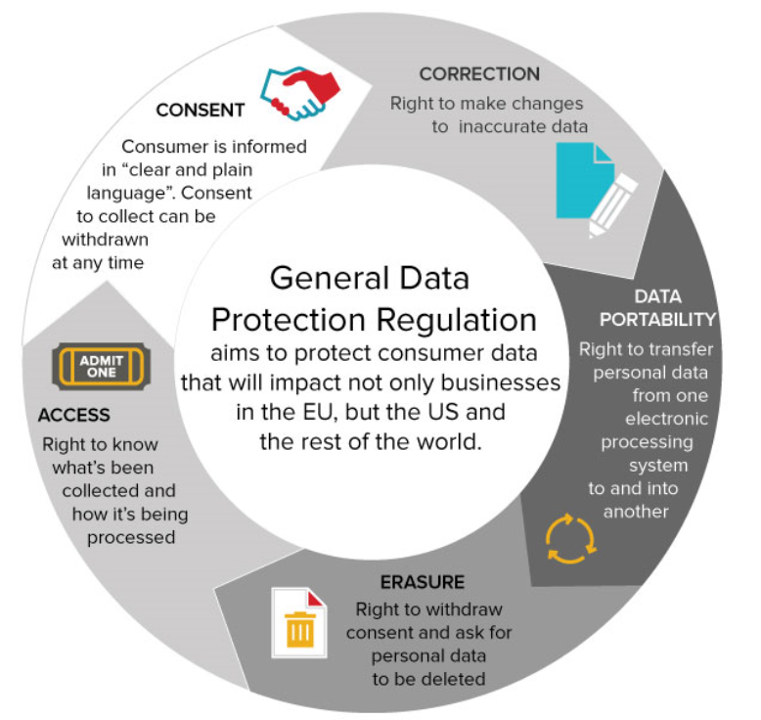
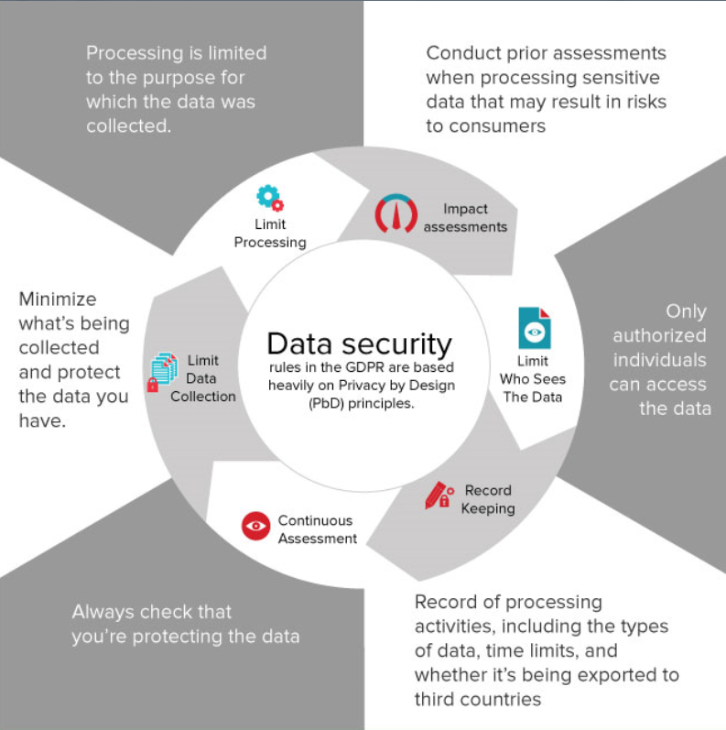
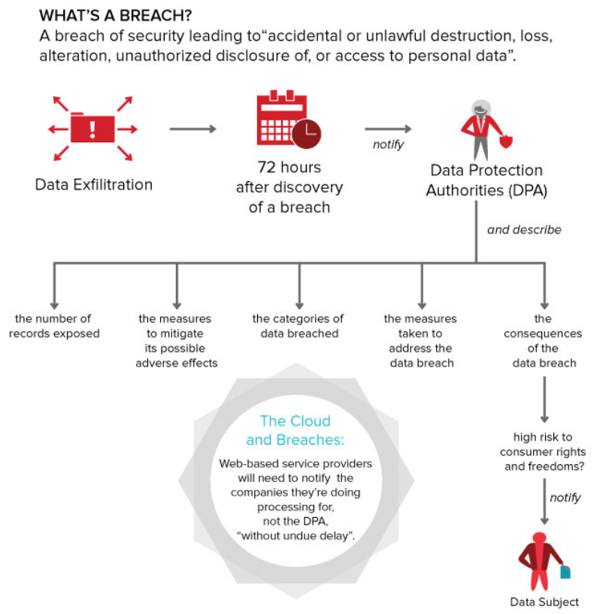
GDPR uitdagingen
Individuals’ Rights
Obligations for Organisations
Breach Response
Notes:
Wat kan een individu vragen? > Organisaties moeten deze vragen kunnen beantwoorden.
Wat met een organisatie zelf regelen
Hoe om te gaan met data lek?

Slide 8
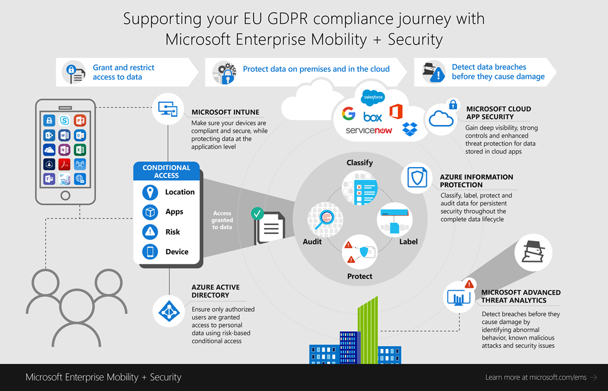
GDPR en Microsoft

Slide 9
Waar gaan wij het over hebben?
Jurgen
Albert
Devices
OFFICE 365
CLOUD SERVICES, SaaS APPs & ON-PREMISES
PCs, tablets, mobile
Exchange Online, SharePoint Online & OneDrive for Business
Highly regulated
Azure
3rd-Party SaaS
Datacenters, file shares
Identity & Access
Windows Information Protection & BitLocker for Windows 10
Office 365 DLP
Office 365 Advanced Data Governance
Intune MDM & MAM for iOS & Android
Azure Information Protection
Microsoft Cloud App Security

Slide 10
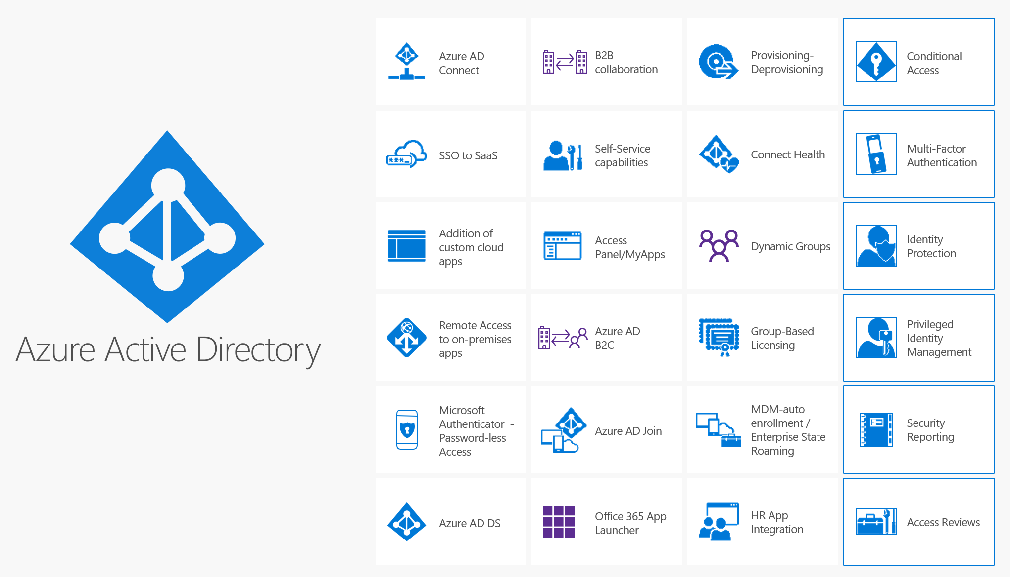
Identity

Slide 11
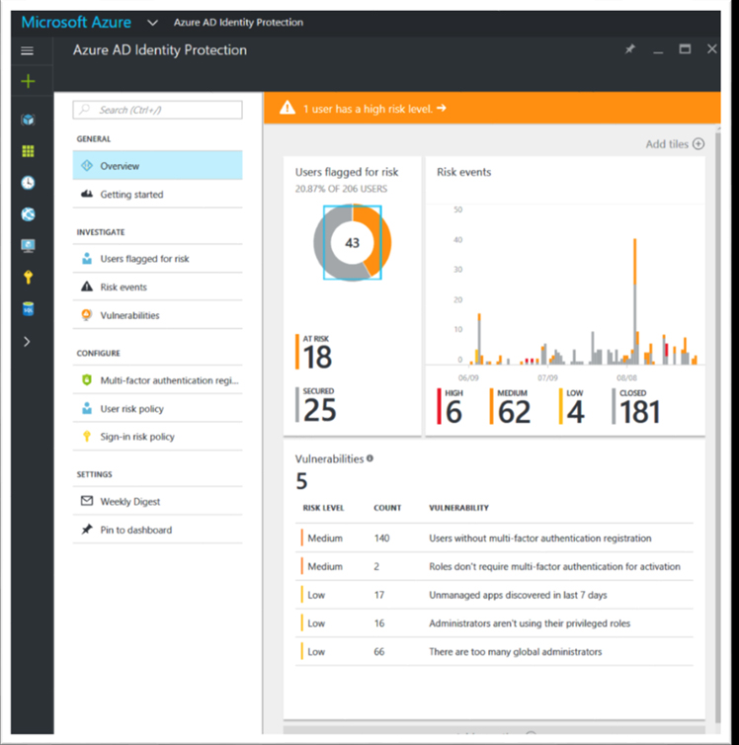
Identity Protection

Slide 12
Demo

Slide 13
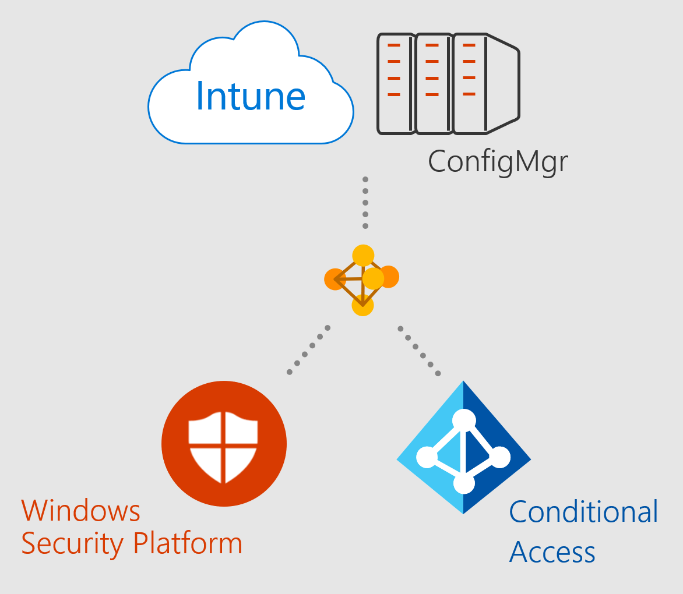
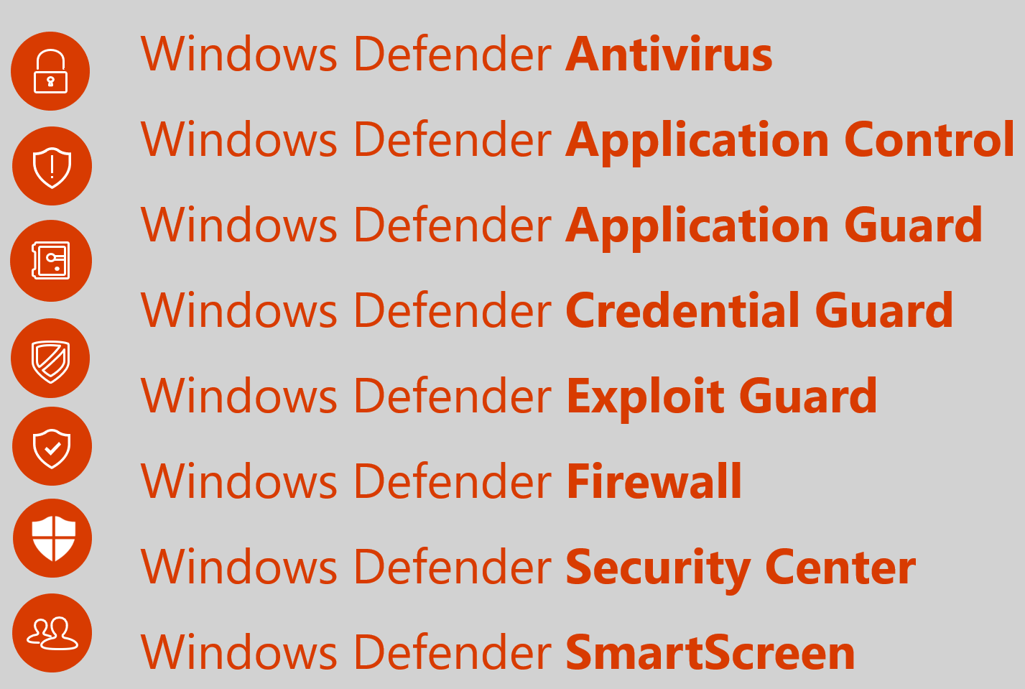
Device

Slide 14
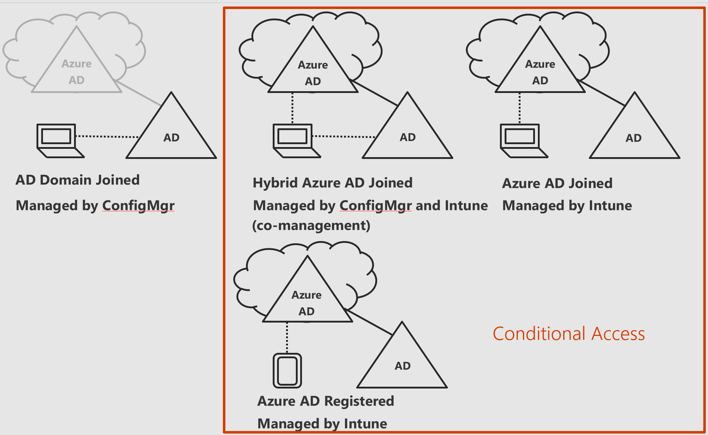
Device - Intune

Slide 15
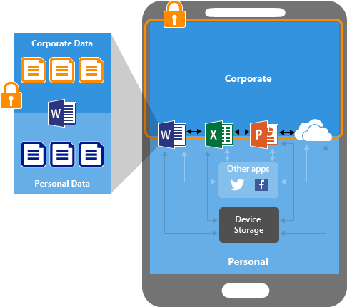
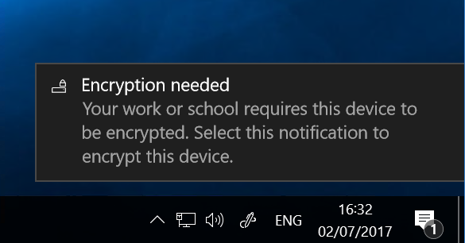
Device & data

Slide 16
Demo

Slide 17
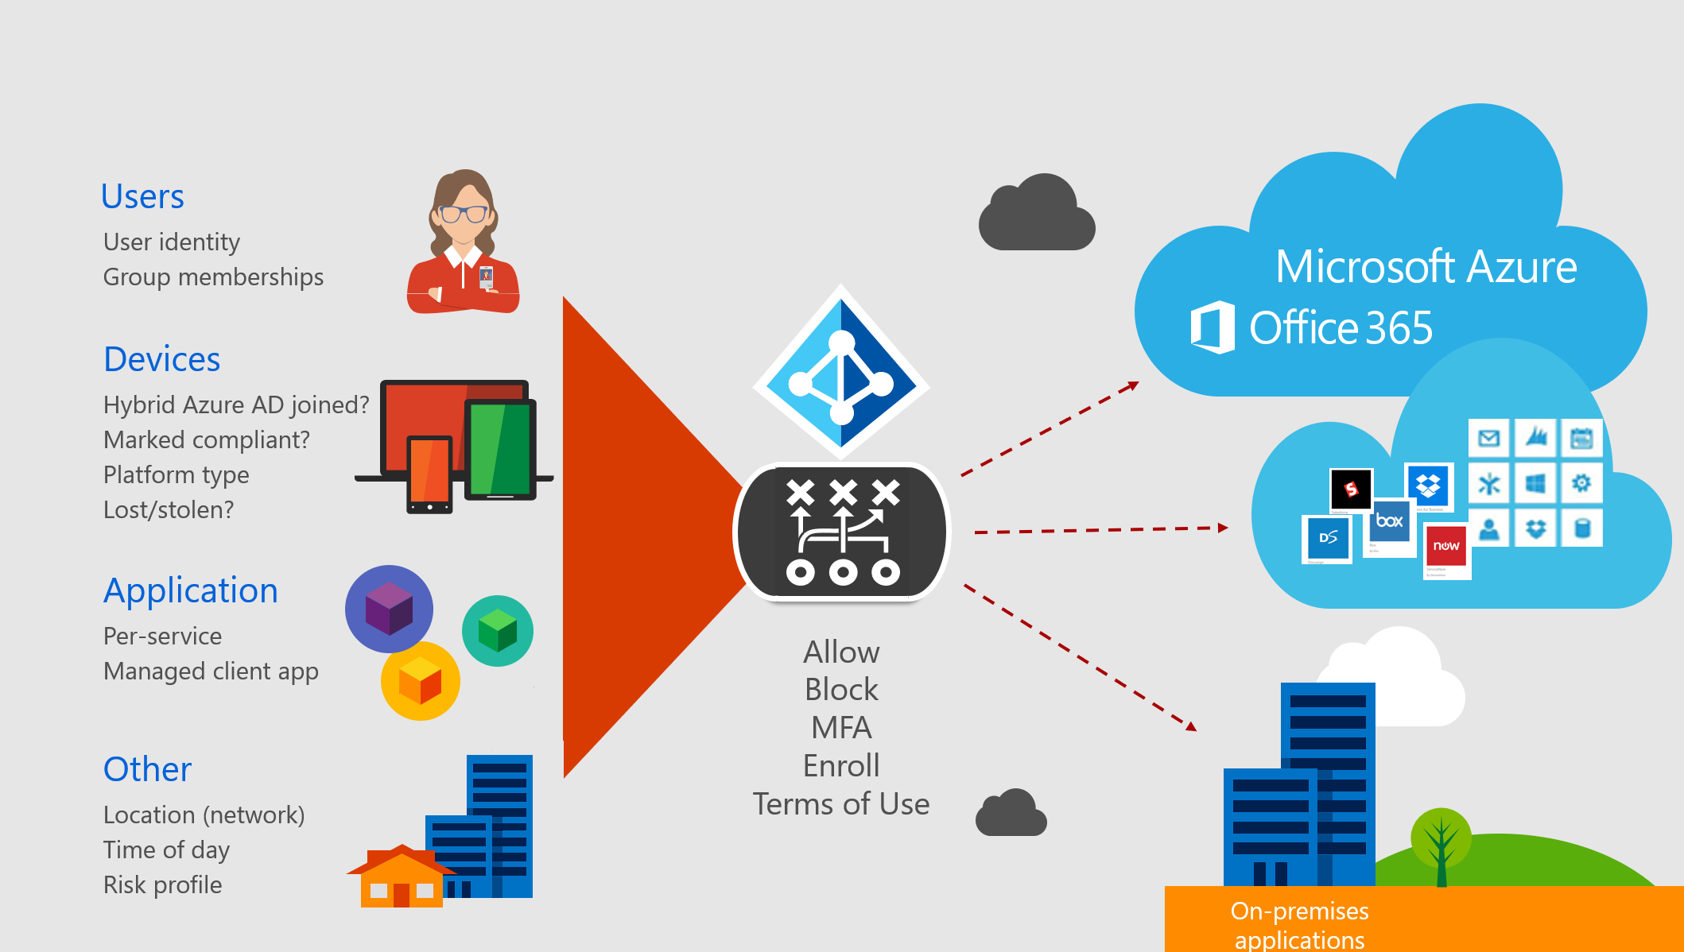
Access control

Slide 18



Access control
Policy Conditions
Policy Controls
Applications
User identity
Group membership
Session Risk
Access Control
Microsoft Cloud
3rd Party SaaS Apps
On Premises Apps
Azure AD Identity Protection Service
User
Allow sign-in
Block sign-in
Microsoft Azure
OS Platform
Is Compliant / Domain joined
Is lost or stolen
Device Risk
Enforce MFA
Device
Windows Defender
Session Restrictions
Mobile or Cloud app
Per app policy
Restrict download
App
Disable print
IP range
Country / Region
Prevent data leak
Location

Slide 19
Demo

Slide 20
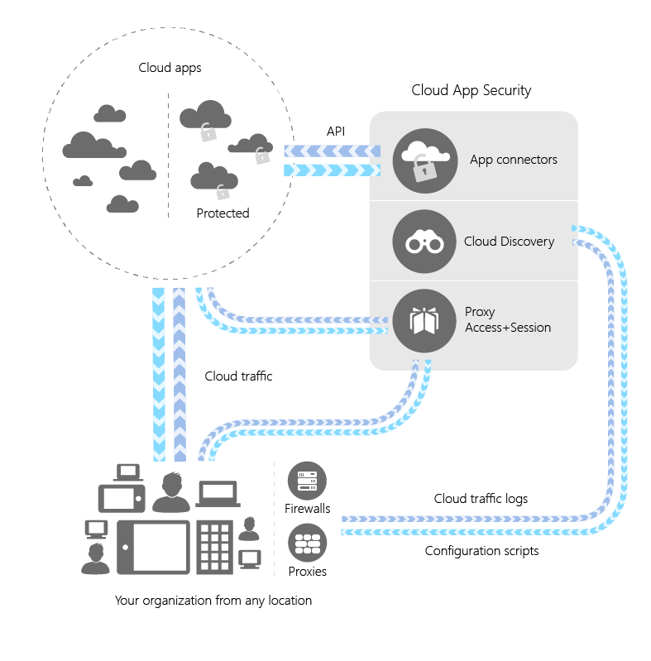
3rd party SaaS & data – Cloud App Security
Discovery
Manually or automatically upload traffic logs files from your firewalls and proxies to discover and analyze which cloud apps are in use
Sanction or block apps in your organization using the cloud app catalog
App connectors
Leverage APIs provided by various cloud app providers to extend protection to Cloud App Security
Proxy apps
Azure AD redirects risky sessions to the reverse proxy to apply app restrictions

Slide 21
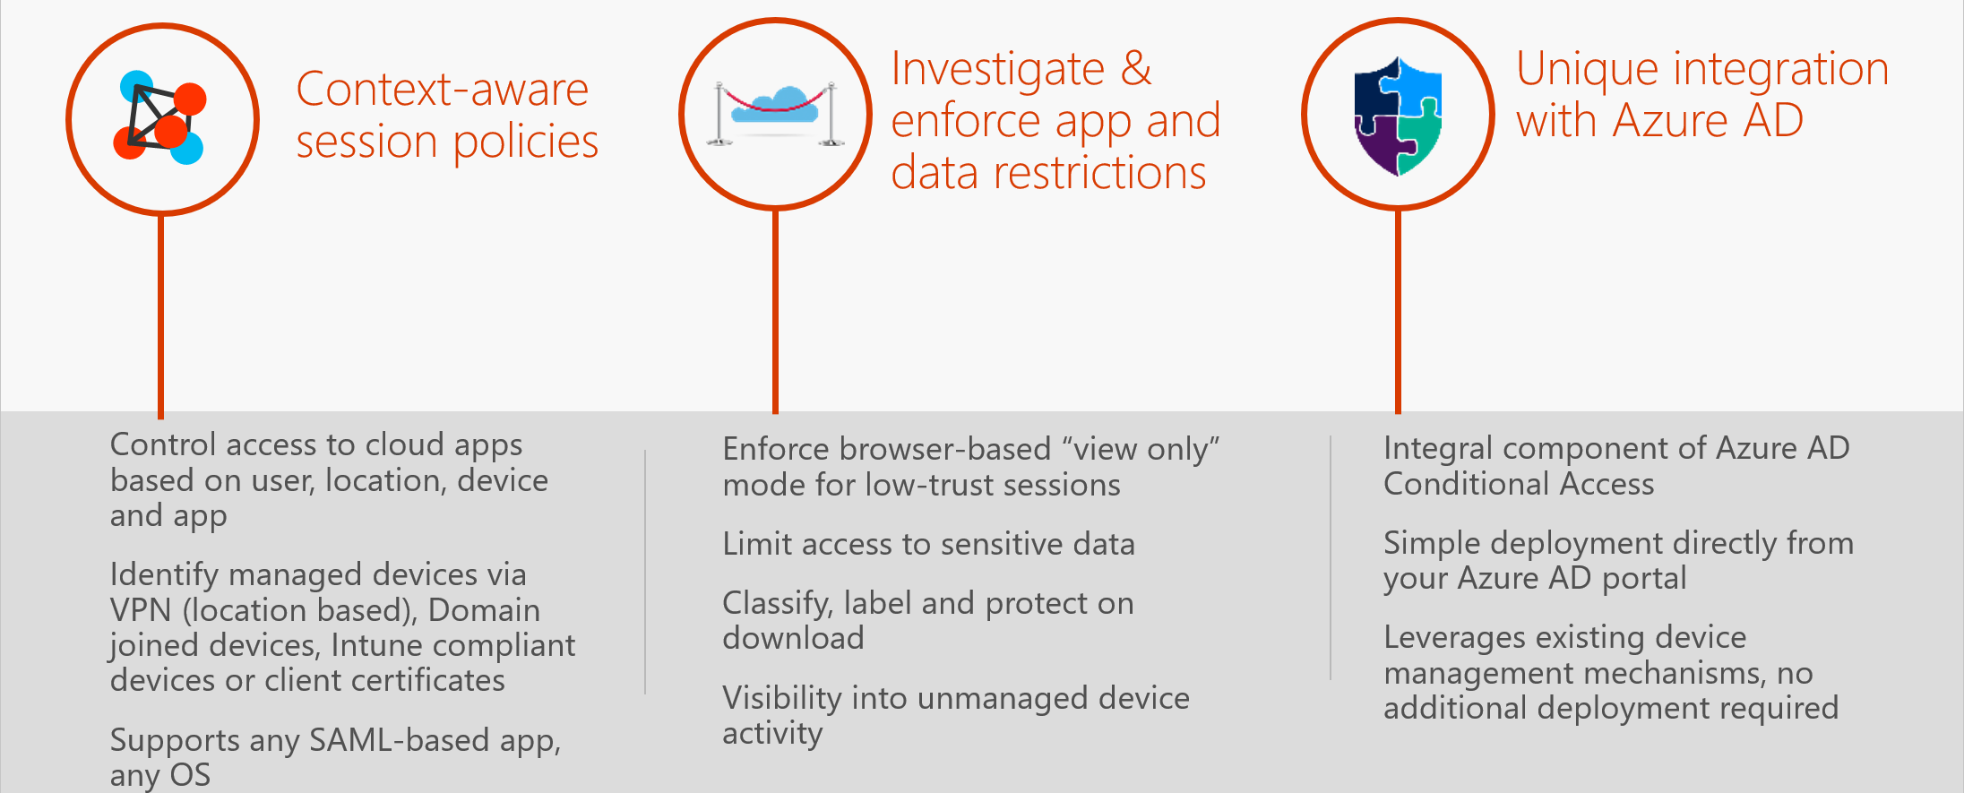
3rd party SaaS & data – Proxy

Slide 22
Demo

Slide 23
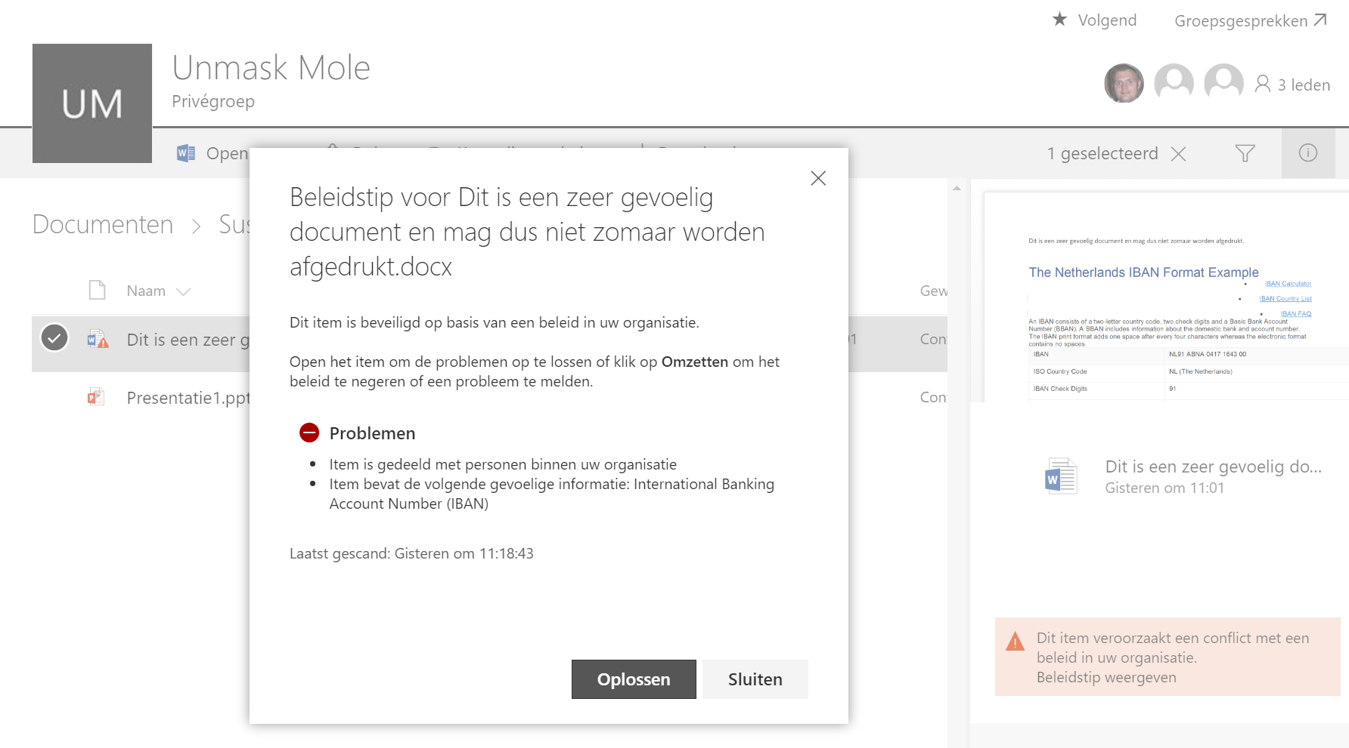
Data governance
Vind informatie
Classificeer informatie
Bescherm informatie
Rapporteer over informatie

Slide 24
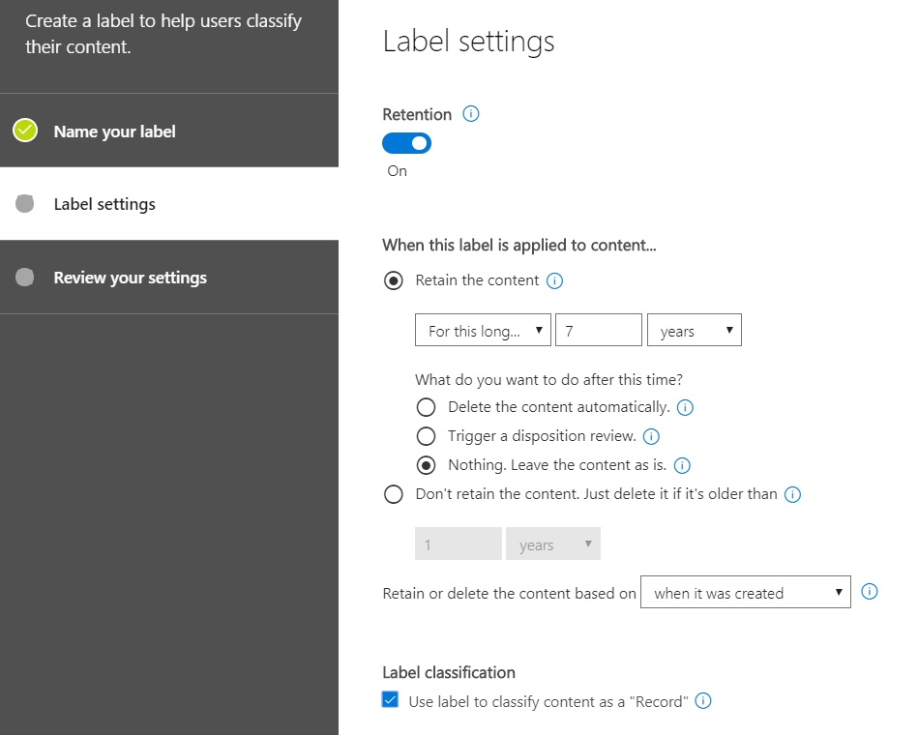
Data governance labels
Labels
Tag content (bijvoorbeeld PII)
Bedoeld voor data retentie, expiratie en record management
Handmatig of automatisch
Specifieke locaties (excl. Skype en Exchange public folders)
Label policy nodig om te activeren
Notes:
Expiration
Deletion
Worden pas toegepast na publicatie

Slide 25
Demo

Slide 26
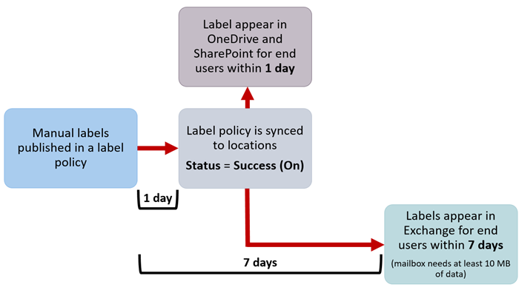
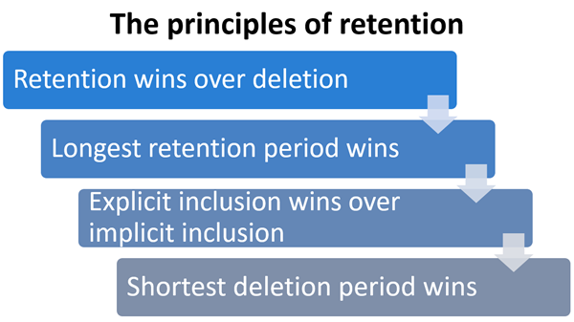
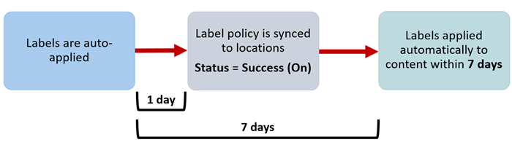
Wanneer toegepast?
Notes:
Vesa

Slide 27
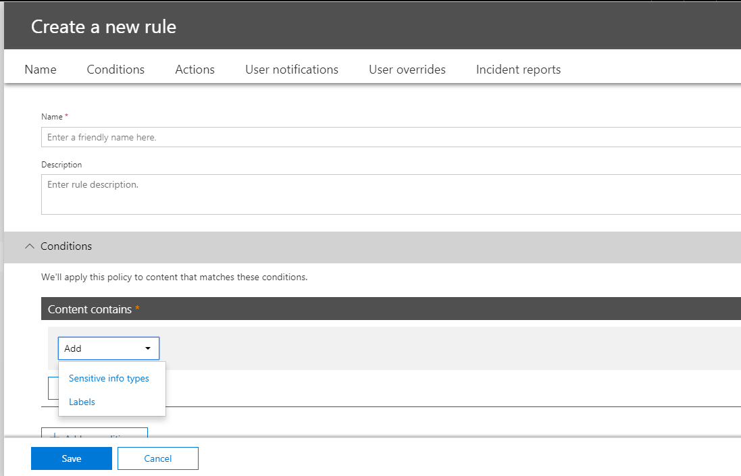
Data loss prevention
Condities
Labels (zie eerder)
Gevoelige content (PII)
Acties
Policy tips
Toegang blokkeren
Notificeren
Notes:
Automatic rules to detect content
Conditions and actions
Notifications
Reports

Slide 28
Demo

Slide 29
Azure Information Protection
INFORMATION PROTECTION LIFECYCLE
Detect
Classify
Protect
Monitor
Scan & detect sensitive data based on policy
Classify data and apply labels based on sensitivity
Apply protection actions, including encryption, access restrictions
Reporting, alerts, remediation

Slide 30
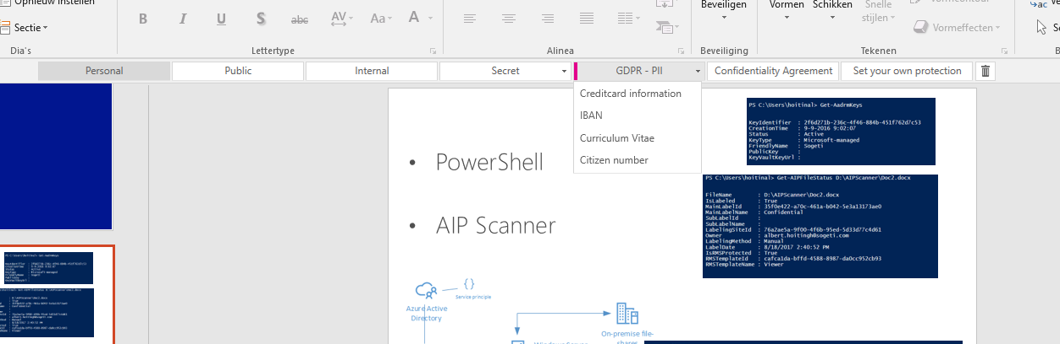
Classificeer, label en bescherm

Slide 31
Demo

Slide 32
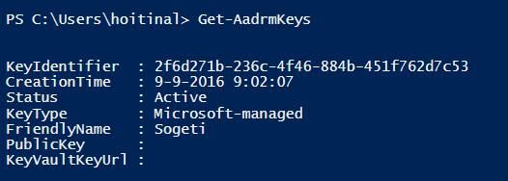
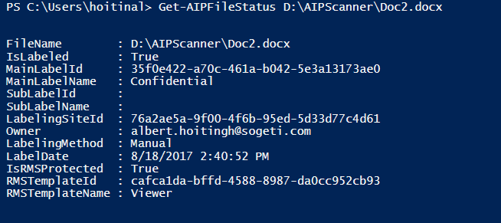
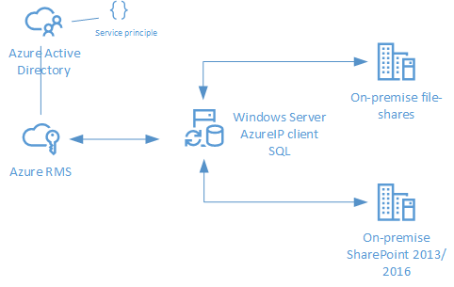
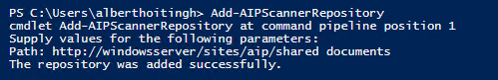
Automatiseren
PowerShell
AIP Scanner
Notes:
Connect-AadrmService
Get-AadrmConfiguration
Get-AIPFileStatus
Set-AIPFileClassification
Set-AIPFileLabel
https://alberthoitingh.com/2017/07/07/azure-information-protection-powershell/

Slide 33
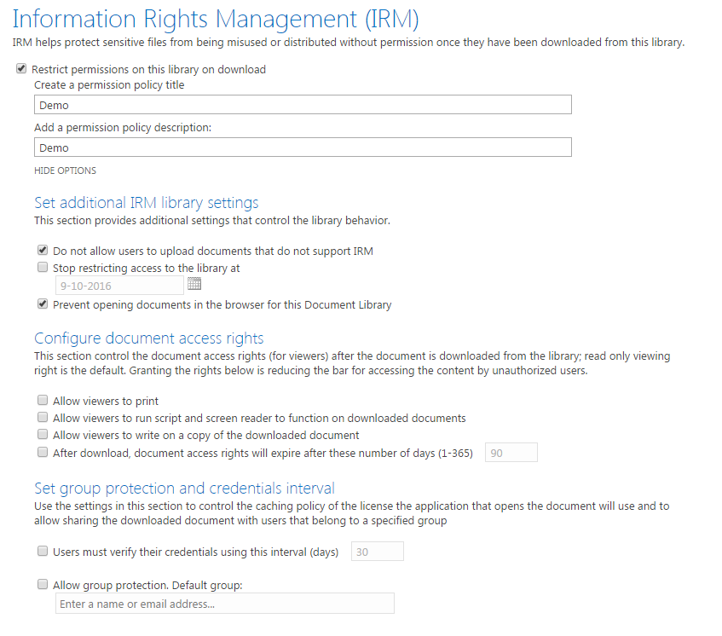
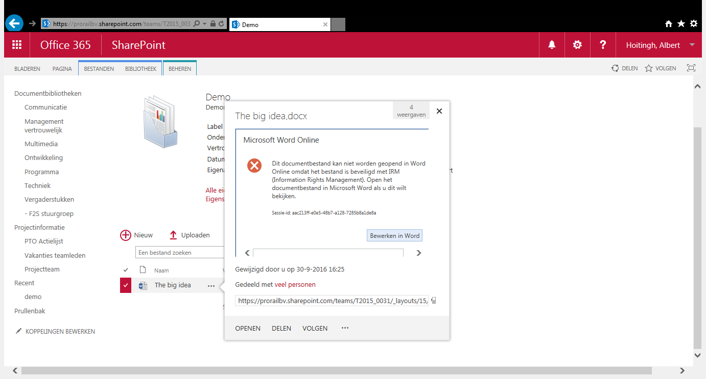
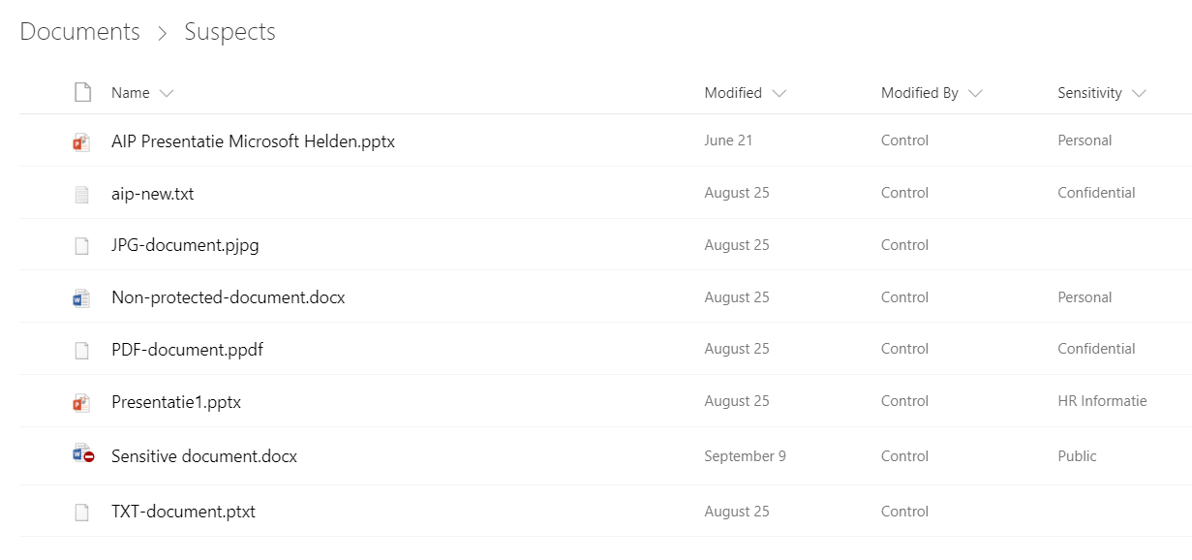
Office 365 en AzureIP
Office 365 governance labels
SharePoint IRM and AIP
Sync AIP labels with SharePoint
Notes:
Je kunt nu wel de labels opnemen in een sharepoint bieb en deze laten synchen
En de advanced data governance labels komen inline met AIP labels

Slide 34
Kortom
Office 365
Windows 10
Enterprise Mobility + Security
Single sign-on Office 365
MFA Office 365
Adv. Security management Office 365
Basic Mobile Device Management
RMS for Office 365
Conditional access
Data loss prevention
Adv. Data governance
Audit log search
Customer lock-box
Windows Defender
Windows Hello
Edge
Device Guard
Wind. Def. Adv. Threat
Device Health
Single sign-in SaaS applications
Full MDM
Conditional accesss
Labeling (Azure Info Protection)
Advanced Threat Analysis
Versleutelde e-mail
Advanced data governance
eDiscovery
Audit log search
Azure AD privileged accountmanagement
Risk based conditional access
Azure AD identity protection
B2B Collaboration
Bring your own key
SQL Always encrypted
Advanced MFA
Cloud App Security
Users self-service management
Certificate provisioning
Workstation management
Azure Information Protection

Slide 35

Discover
Office 365 and Azure
Protect
Report
Azure Information Protection
Office 365 eDiscovery
Azure Data Factory
Azure HDInsight
Azure Data Catalog
Data governance
Data loss prevention
Mobile Device Management
Azure Information Protection
Office 365 Message Encryption
Microsoft Cloud App Security
Azure Key Vault
Azure HDInsights
Office 365 auditlog
eDiscovery cases/content search
Additional or non-Microsoft
Forms and workflows (Flow/PowerApps/Nintex/LogicApps)
Content Search (across multiple repositories)
Document/report creation
Back-up solutions (Commvault) – right to be forgotten….
Notes:
Key messages:
Meet compliance requirements by implementing data retention and time-based hold policies.
Perform eDiscovery quickly and significantly reduce the cost and time of producing required documentation for inquiries
Work together to crowd-source answers to regulator requests. Avoid raising flags by multiple people answering questions in multiple ways.
Have a single version of the truth rather than versions in data warehouses.
Data Source
Source “The Total Economic Impact of Microsoft Office 365 for Manufacturing Organizations”
Based on surveys of 35 manufacturing organizations, respondents indicated on average, reduced compliance costs by 12.3% and reduced time spent on eDiscovery efforts by 10.5%
E5 Value:
Office 365 Advanced eDiscovery integrates Equivio machine learning, predictive coding and text analytics capabilities, to reduce the costs and challenges that come along with sorting through large quantities of data for eDiscovery purposes. In today’s data environment, the eDiscovery process for any given case could involve sorting through millions of emails, text messages, instant messages and documents to find the small number of files that are most relevant. Office 365 Advanced eDiscovery reduces the volume of data by eliminating duplicate files, reconstructing email threads and identifying key themes and data relationships. Finally, it enables users to train the system to intelligently explore and analyze large, unstructured data sets and quickly zero in on what is relevant.
Other Scenario Solutions (not E5 specific):
Meet regulatory compliance needs
Microsoft provides proof of qualification for many regulations such as SAS 70 Type II, SAFE Harbor, ISO 27001, HIPAA, FISMA, GxP. Microsoft will issue a business associate agreement (BAA) for HIPAA, meaning Microsoft take responsibility for any regulatory shortfalls of the Office 365 service. Comply with 21 CFR Part 11 with digital signatures in Office documents and SharePoint workflows.
E-Discovery
With the unified eDiscovery Center, you can search across SharePoint, Skype for Business, and Exchange mailboxes. eDiscovery integrates with advanced retention and archiving, enabling in-place legal hold and case-based projects.
In-Place Hold
The ability to place legal holds on mailboxes without the user knowing in the case of potential legal action.

